Slide 1



Planning Resilient EV Charging
Lori Clark, Savana Nance, Hannah Thesing
NCTCOG Transportation Department
NTX-REV Stakeholder Input Session
March 26, 2025

Slide 2
DOE Acknowledgement
This material is based upon work supported by the Joint Office of Energy and Transportation through the U.S. Department of Energy’s Office of Energy Efficiency and Renewable Energy (EERE) under Award Number DEEE0011235.

Slide 3


Agenda
Kickoff
The Need for Resilient EV Charging
Check In: Questions?
Scope Overview and Establishing Regional Objectives, Outputs, & Outcomes
Framing the Project
Check In: Questions?
Resilient Charging Technologies and Strategies
Introduction, Comparison, and Regional Adaptations
Gap and SWOT Analyses
Check In: Questions?
Final Remarks
NTX-REV Stakeholder Input Session
Notes:
5 minutes Meeting Kick Off
10 minutes Project Overview: Resilient EV Charging
Project Purpose and Overview
Project Objectives
5 minutes Engagement + Questions
10 minutes Scope Overview and Establishing Regional Objectives, Outputs, and Outcomes
10 minutes Engagement + Questions
10 minutes Gap Analysis: Resilient Charging Technologies and Strategies
10 minutes Engagement + Questions
5 minutes Final Remarks

Slide 4






Transportation Department: Clean Fuels & Energy
Key Focus Areas & Goals
What We Do
Funding Support
Clean Vehicle Initiatives
Technical Assistance
Alternative Fuel Infrastructure Initiatives
Planning the Future
Energy Integration & Community Readiness
Raising Awareness
NTX-REV Stakeholder Input Session
Notes:
The Clean Fuels and Energy Team is divided into three smaller teams, the Clean Vehicle Initiatives team, the Infrastructure Planning and Readiness team, and the Energy Integration and Community Readiness team. Each team has a specific set of goals that they work to accomplish. These goals are detailed in the Dallas-Fort Worth Clean Cities Strategic Plan, and they are summarized here. The Clean Vehicle Initiatives team works to support the transition to alternative fuel vehicles, especially zero and near-zero emission vehicles. The Infrastructure Planning and Readiness team works to build and support reliable alternative fueling infrastructure, emphasizing stations that are publicly accessible. The Energy Integration and Community Readiness team works to support communities in their transition to alternative fuels, ensuring all the pieces of the puzzle fit together, adding components such as grid resiliency and workforce development.
For more on exactly what we do both as a Clean Cities Coalition and as part of the COG, we provide funding support for our stakeholders and sometimes even administer the funding ourselves, like with a few of the grants my colleague Maggie is going to talk about later. We provide technical assistance by maintaining and analyzing data, hosting webinars, workshops, and peer exchanges, and by sharing best practices and template resources. We do a lot of planning for the future by participating in the designation of alternative fuel corridors, working with the Texas Department of Transportation to implement the Texas EV Charging plan, and securing funding for and planning zero-emission vehicle infrastructure. We also work to raise awareness of alternative fuels by facilitating stakeholder relationships and hosting events for the public like National Drive Electric Week and our annual fleet recognition awards.

Slide 5



Emergency Preparedness Department
Key Focus Areas & Goals
What We Do
Regional EV Infrastructure Resiliency Plan
Administer Table-top Exercise
Assist with field demos and workshop
Grants Management and Administration
Regional Planning Support
Training and Exercise Support
Facilitate Regional Working Groups and Committees
NTX-REV Stakeholder Input Session
Notes:
The Clean Fuels and Energy Team is divided into three smaller teams, the Clean Vehicle Initiatives team, the Infrastructure Planning and Readiness team, and the Energy Integration and Community Readiness team. Each team has a specific set of goals that they work to accomplish. These goals are detailed in the Dallas-Fort Worth Clean Cities Strategic Plan, and they are summarized here. The Clean Vehicle Initiatives team works to support the transition to alternative fuel vehicles, especially zero and near-zero emission vehicles. The Infrastructure Planning and Readiness team works to build and support reliable alternative fueling infrastructure, emphasizing stations that are publicly accessible. The Energy Integration and Community Readiness team works to support communities in their transition to alternative fuels, ensuring all the pieces of the puzzle fit together, adding components such as grid resiliency and workforce development.
For more on exactly what we do both as a Clean Cities Coalition and as part of the COG, we provide funding support for our stakeholders and sometimes even administer the funding ourselves, like with a few of the grants my colleague Maggie is going to talk about later. We provide technical assistance by maintaining and analyzing data, hosting webinars, workshops, and peer exchanges, and by sharing best practices and template resources. We do a lot of planning for the future by participating in the designation of alternative fuel corridors, working with the Texas Department of Transportation to implement the Texas EV Charging plan, and securing funding for and planning zero-emission vehicle infrastructure. We also work to raise awareness of alternative fuels by facilitating stakeholder relationships and hosting events for the public like National Drive Electric Week and our annual fleet recognition awards.

Slide 6
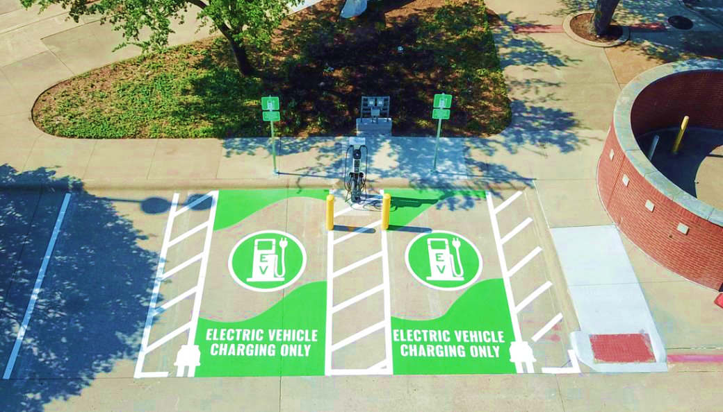
The Need for Resilient Electric Vehicle Charging
Image Provided By Dallas Area Rapid Transit

Slide 7
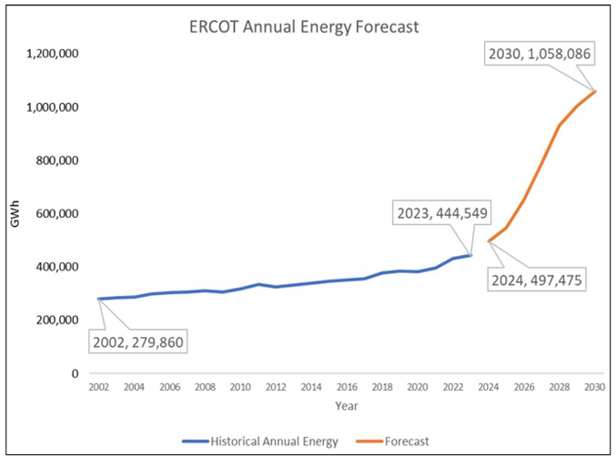
Why: Increasing Demand on the Grid
Largest contributors to demand increase (Large Load)
Cryptocurrency mining
Data centers – AI usage contributing factor
Hydrogen production
Large industrial
17.1% Annual Growth
3.1% Annual Growth
1 Gigawatt Hour (GWh) could power: ~ 1.1 million homes for an hour; 1 electric car for 3 million miles
Source: www.ercot.com/gridinfo/load/forecast ->Long-Term Hourly Peak Demand and Energy Forecast
Notes:
Average Annual Growth Rate (AAGR) for energy refers to the average yearly percentage increase or decrease in the total energy consumption or production within a specific region or market over a given period, calculated by taking the mean of the year-on-year growth rates across that timeframe
Largest contributors to demand increase (Large Load)
Cryptocurrency mining
Data centers – artificial intelligence (AI) usage contributing factor
Hydrogen production
Large industrial
EV Registration 2029 Forecast
998,000 light-duty and 103,000 medium- and heavy-duty vehicles will be EVs
96% of light-duty EVs and 93% of medium- and heavy-duty EVs in ERCOT territory
EV charging will only add 1.25% to ERCOT’s load forecast
up from 0.2% in 2023
What is a Gigawatt Hour?
Gigawatt (GW): A gigawatt is 1,000 megawatts, or 1 billion watts. At this level, we’re talking about the capacity of large power plants or the amount of energy used by a city.
Gigawatt Hour (GWh): One gigawatt hour equals 1,000 MWh or 1 million kWh. To put that in perspective:
One GWh could power:
About 1.1 million homes for an hour.
300 million smartphone charges.
An electric car for 3 million miles (that’s like driving around the Earth 120 times!).

Slide 8
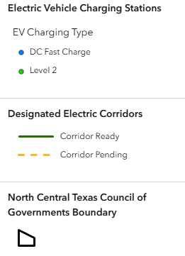
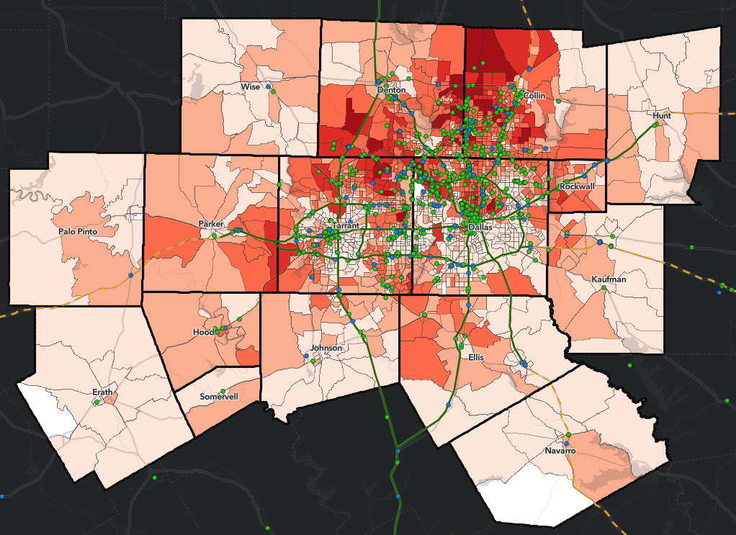
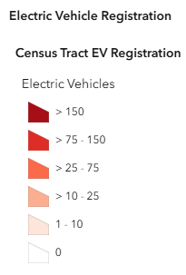

Why: Increasing EV Adoption
Electric Vehicle (EV) Registration Data
dfwcleancities.org/evnt -> EVs and Texas
Charging Ports Statewide (includes Tesla):
7,460 Level 2
3,249 DC Fast
afdc.energy.gov/stations
Region | March 2024 | March 2025 | Increase
Texas | 259,339 | 357,334 | 38%
Dallas-Fort Worth (DFW) | 96,238 | 131,114 | 36%
Austin | 51,083 | 70,489 | 38%
San Antonio | 23,715 | 30,512 | 29%
Houston | 64,196 | 90,045 | 40%
Data as of March 2025
ERCOT projects 998,000 light-duty and 103,000 medium- and heavy-duty EV by 2029
EVs will be increasingly assigned to critical operations (ex: public safety, public works, freight transport, etc.)
However, EV charging only expected to add 1.25% by 2029
ERCOT projects 998,000 light-duty and 103,000 medium- and heavy-duty EV by 2029
ERCOT projects 998,000 light-duty and 103,000 medium- and heavy-duty EV by 2029
NTX-REV Stakeholder Input Session
Notes:
Maggie start here

Slide 9
Why: Decreasing Grid Reliability
More outages in last 5 years than any other state
Outages lasted ~160 minutes impacting an est. 172,000 Texans
Most outages caused by severe weather and failure of systems operations
Other possible causes: Aging Infrastructure, Vandalism, Transmissions Operations, Natural Disaster, Physical Attack, or Other
Cause of Outage | Outages Last 5 Years (2019-2023) | Outages Last 20 Years (2003-2023) | Percent of Outages in Last 20 Years Occurring in Last 5 Years
Severe Weather | 111 | 193 | 58%
Systems Operations | 45 | 62 | 73%
All Causes | 263 | 435 | 60%
Source: Payless Power
NTX-REV Stakeholder Input Session
Notes:
Define outage which is no power being supplied from the grid within a certain geographical area; can be caused by many things, including severe weather, natural disasters, human error, vandalism, equipment failure, fallen trees, animals, high energy demand, planned outages, excavation digging, geomagnetic disturbances from the Sun, and cyberattacks.
Define severe weather which in the paper is listed as such as high winds, rain, and thunderstorms

Slide 10
Questions?
Image Provided By Dallas Area Rapid Transit

Slide 11
Scope Overview and Establishing Regional Objectives, Outputs, & Outcomes
Image Provided By Dallas Area Rapid Transit

Slide 12

Setting the Scope
Source: Getty
Objective:
Create North Texas Resilient Electric Vehicle (NTX-REV) plan for 16-county NCTCOG region to continue critical electric vehicle operations
Outputs:
Draft and final NTX-REV Plan
Updated Hazard Mitigation guidance
Outcomes:
Increased awareness and understanding of the risks and potential solutions surrounding electrification of critical EV operations and EV charging
Improved readiness in the event disruption occurs
  Project Timeline
    October 2024- July 2025*
    Research and Engagement
    NTX-REV Plan Drafting
    August 2025 – September 2026*
    Demo Project Development & Implementation
    October 2026 – March 2027*
    Plan Finalization and Distribution
*Timeline may be adjusted pending DOE approval
NTX-REV Stakeholder Input Session
NTX-REV Stakeholder Input Session
Notes:
Project Objectives:
"The objective of this project is to develop an electric vehicle (EV) charging resiliency plan for the North Central Texas Council of Governments (NCTCOG) planning area to ensure continued access to EV charging services in the event of grid disruptions. The plan will identify and suggest actions to enhance EV charging resiliency while also addressing grid resiliency issues related to the increased demand for electricity due to EVs. A demonstration project will be carried out to implement aspects of and ensure replicability of the resiliency plan. The demonstration project and plan will outline how existing equipment reserves can be utilized to maintain access to charging services through an actionable and replicable plan." - SOPO
Develop an actional and replicable EV charging resiliency plan
Identify and suggest actions
Address grid resiliency issues
Conduct demos
Outline how existing resources can be utilized
Purpose:
"The project end goal is to “harden” the region’s EVSE against a grid outage to enable electrified transportation assets to continue operations with minimal disruption. This will be accomplished by identifying appropriate resilience strategies, determining relative costs and impacts of each option, updating regional response procedures to incorporate findings, and recommending implementation at a subset of EVSE. Recommendations will be provided to public sector stakeholders who may implement requirements for identified EVSE to be made resilient". - Technical Volume
Impacts, Outputs, Outcomes:
"The most immediate project impacts include adoption of resiliency strategies by entities in the region and integration of preparedness recommendations into individual existing jurisdictional EP plans. The project will result in the following key deliverables:
A comprehensive list of project collaborators including relevant experience and qualifications; roles and responsibilities; and anticipated impacts or benefits to each entity.
A draft NTX-REV Plan reflecting input from collaborators and community engagement, including, an inventory of risk mitigation and resiliency strategies, a SWOT and gap analysis, and outline of feasible resiliency strategies to be tested during the demonstration projects.
The final NTX-REV Plan, reflecting the draft plan and updated using results of two demonstration projects. The final plan will provide recommendations for appropriate resilience strategies and priority sites for implementation. Project partners will assist in the determination of appropriate metrics to be assessed during the demonstration project and will provide data on the assessed metric to NCTCOG for inclusion in the final plan.
Updated regional hazard mitigation planning guidance to incorporate recommendations made in the final NTX-REV Plan.
Long-term impacts will include increased ability of transportation assets to continue operating normally even in instances of a power interruption, with minimal disruption to standard operating procedures.
A key output of the Plan will be increased awareness and understanding among fleet operators, transportation planners, and EP staff of the risks and potential solutions surrounding disruptions to EV charging, which will enable improved readiness and abilities to plan appropriate responses in the event such a disruption occurs.... The Project Team will engage entities in stakeholder engagement early and throughout the project. Key points of discussion will include (1) identifying the most important transportation services for which continuity of operations must be ensured, and (2) identifying specific training needs to equip the local workforce in participating in new job opportunities created by this plan." - SOPO
Parameters/Metrics:
"Project outcomes will include development of a regional plan and implementation of two demonstration projects, including both a tabletop exercise and a deployment demonstration. Metrics to be evaluated during the demonstration projects will include the total number of EV miles of travel enabled, the amount of downtime between power loss and the resilient technology’s ability to provide back-up power, the time taken to charge the EV to a pre-determined level, and the number of EVs able to charge to the pre-determined level at the station using back-up power. "

Slide 13
Sample Plan Outline
Introduction to Region
Purpose of the Project
Project Objectives
Scope
Assumptions
Roles and Responsibilities
SWOT Analysis
Gap Analysis
  Critical EV Infrastructure/Assets
  Areas to Add Resilient EV Infrastructure
Resources
NTX-REV Stakeholder Input Session

Slide 14
NTX-REV Project Team
Stakeholders
Key Partners
Roles:
Share resources
Demo participation
Data sharing
Entities:
  Provided a letter of support during NCTCOG’s application to the Joint Office
Project Manager
NCTCOG
Transportation Department
Emergency Preparedness Department
Role:
Coordinate Meetings
Create Plan
Manage/Project and Budget
Entities:
Sustainability Org.
Utilities
EV Charger Owners
Local Governments
Non-profits
Fleets
Roles:
Provide input to plan
Engage relevant stakeholders
Distribute plan
Know someone who may be interested? Please share the NTX-REV flyer or sign-up form available at www.cleancities.org/NTx-REV
NTX-REV Stakeholder Input Session
Notes:
Key Partners: Provide input on plan
Provide assets for demonstration
Support adoption and distribution of plan

Slide 15
Discussion
What would you like to get out of this project?
What do you think is important for us to include?
NTX-REV Stakeholder Input Session
Notes:
5 minutes Meeting Kick Off
10 minutes Project Overview: Resilient EV Charging
Project Purpose and Overview
Project Objectives
5 minutes Engagement + Questions
10 minutes Scope Overview and Establishing Regional Objectives, Outputs, and Outcomes
10 minutes Engagement + Questions
10 minutes Gap Analysis: Resilient Charging Technologies and Strategies
10 minutes Engagement + Questions
5 minutes Final Remarks

Slide 16
Discussion
What concerns do you need to address about critical EV/ grid resilience?
What are issues is your organization seeing in the field?
  Ex. No backup methods of charging, issues with response time, difficulties with repairs, sourcing vendors/parts, etc.
NTX-REV Stakeholder Input Session

Slide 17
Resilient Charging Technologies
Image Provided By Dallas Area Rapid Transit

Slide 18

Potential Resiliency Technologies
Technology | Independent Source of Power? | Storage for Off-Grid Charging
Energy Storage Systems: Batteries or Hydrogen Fuel Cell |  | Yes
On Site Renewable Generation: Solar or Wind | Yes; Intermittent
Generators: Gasoline, Natural Gas, or Diesel | Yes | Yes
Mobile Charging: Mobile Charging Unit or Vehicle to Vehicle Charging |  | Yes
Microgrids | Yes | Yes
See Whitepaper titled, "Planning for Resilient EV Charging Infrastructure". Developed by NCTCOG
The Texas State Energy Conservation Office (SECO). Highlights key strategies for achieving resilient EV charging

Slide 19
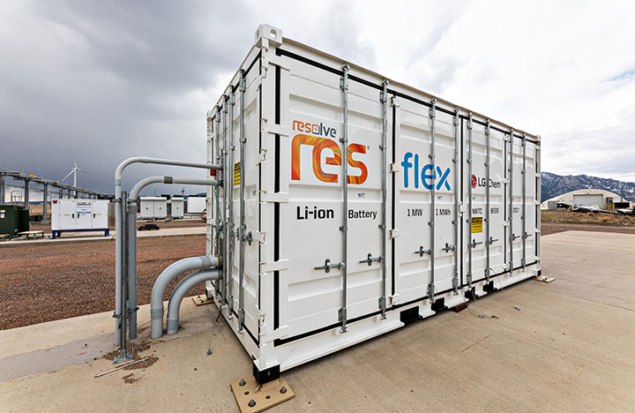
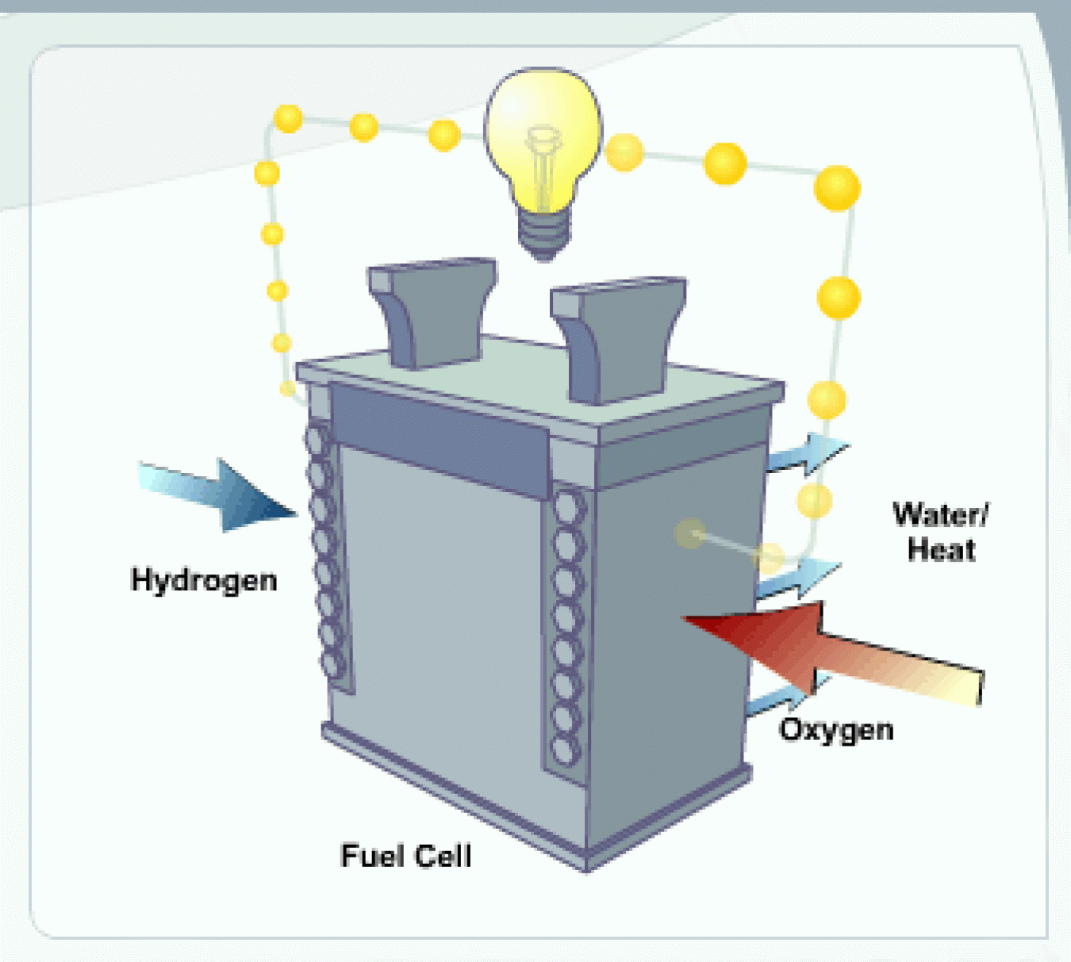
Energy Storage Systems
Battery Energy Storage System (BESS) and Hydrogen Fuel Cell Energy Storage
Lessen grid impact; scalable; standalone or connected to the grid
Battery integrated chargers allow for off-grid charging
Offer backup power and stationary power for electricity generation used in microgrids and larger scale applications
Source: NREL​
Source: NREL​
NTX-REV Stakeholder Input Session
Notes:
Battery Energy Storage System (BESS)
Grid Connected BESS
Batteries charged by grid
During an outage, the battery is a backup power source
Standalone Charger w/BESS
Relies on stored energy
Charged by external source (i.e. solar)
Hydrogen Fuel Cell Energy Storage
Standalone charger
Powered by fuel cell
Fuel cell refueled with hydrogen
Grid connected charger
Hydrogen fuel cell is power backup

Slide 20
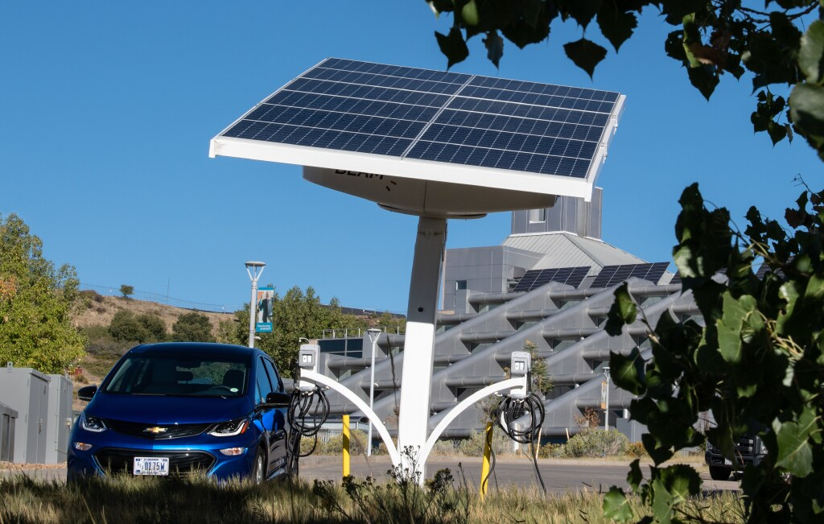
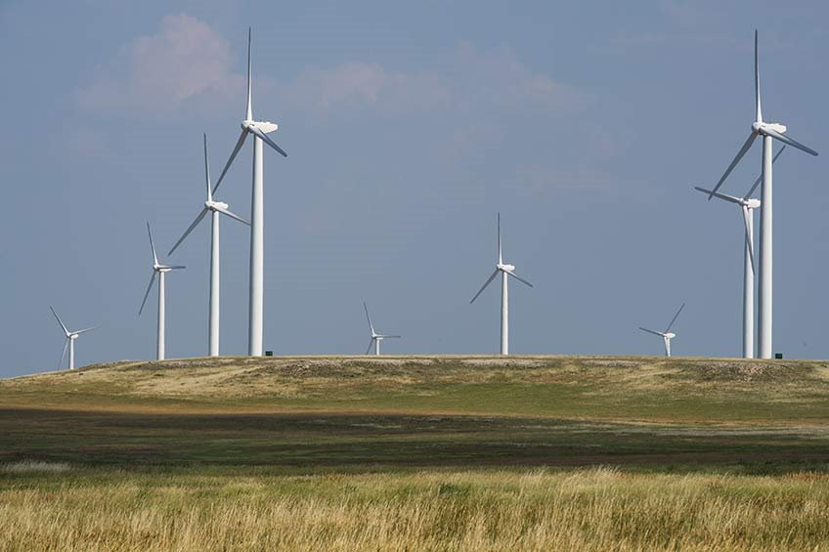
On Site Renewable Generation
Solar and Wind
Lessen grid impact; scalable; can be integrated as a DER
Off-grid capable when integrated with energy storage (usually battery)
Added energy storage needed for long term resiliency
Low lifecycle emissions
Efficiency gains when locally deployed
Source: Beam Global
Source: NREL
NTX-REV Stakeholder Input Session
Source: NREL
Notes:
renewable energy and has low lifecycle emissions

Slide 21
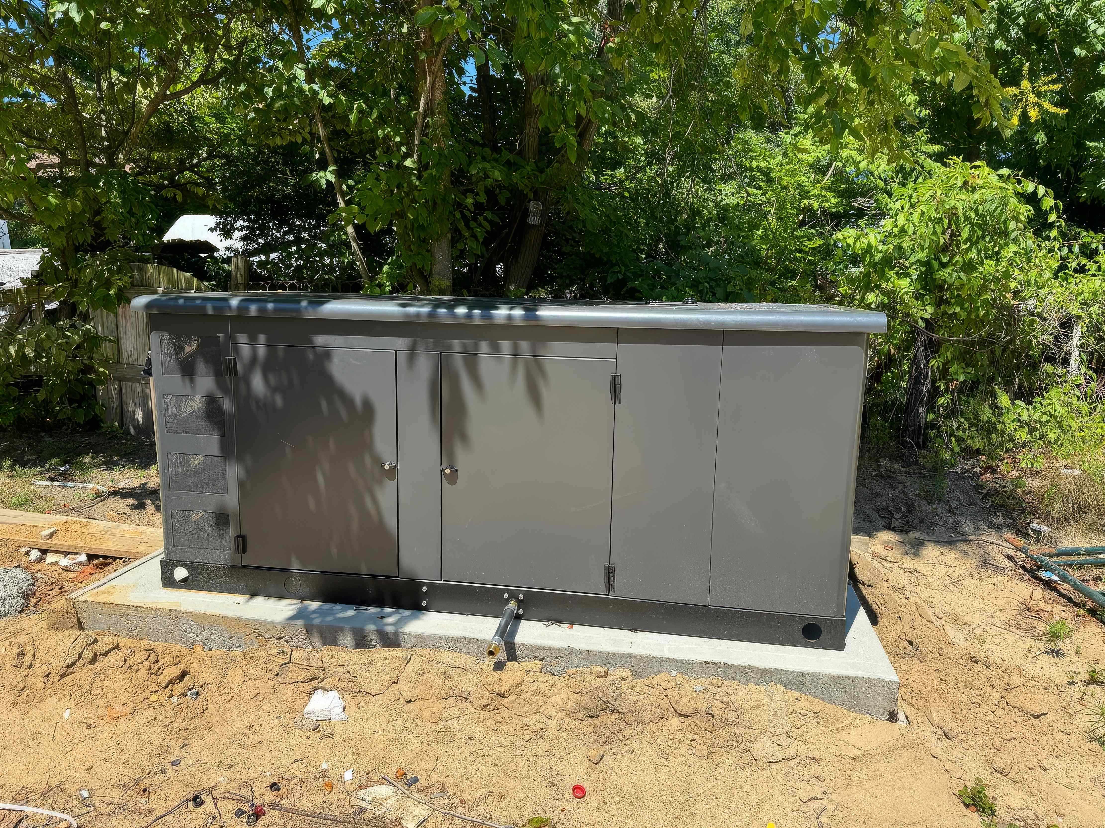
Generators
Powered by a variety of fuel sources: propane, diesel, natural gas
Combustion-fueled generators:
  Lower upfront cost compared to battery and solar backup
  Higher power density and fuel efficiency
  Depending on size could be mobile
  Propane’s carbon intensity is lower than electricity generated from the Texas grid mix
Source: Texas Propane Gas Association
NTX-REV Stakeholder Input Session
Notes:
Combustion-fueled generators
Lower upfront cost compared to battery and solar backup
Higher power density and fuel efficiency
Depending on size could be mobile
Propane’s carbon intensity is lower than electricity generated from the Texas grid mix
However:
Most have a higher carbon intensity than the rest of the technology options
Maintenance and fuel costs are higher than battery and solar backup
Non-fuel operating cost of diesel and natural gas generators are higher than solar or battery
Carbon Intensity: Measures how much carbon dioxide (CO2) equivalent are released for a given amount of a material or product. For purposes of measuring carbon intensity in the energy/electricity sector, this is usually expressed in grams of CO2e per kilowatt-hour (kWh) of electricity. This metric accounts for the emissions of various greenhouse gases, converting them into CO₂ equivalents to provide a comprehensive view of the environmental impact.
Propane has a lower carbon intensity than electricity from the Texas grid. The former emits 78 grams of carbon dioxide (CO2) equivalent per megajoule (MJ), while the latter emits 140 grams of CO2 per MJ.

Slide 22
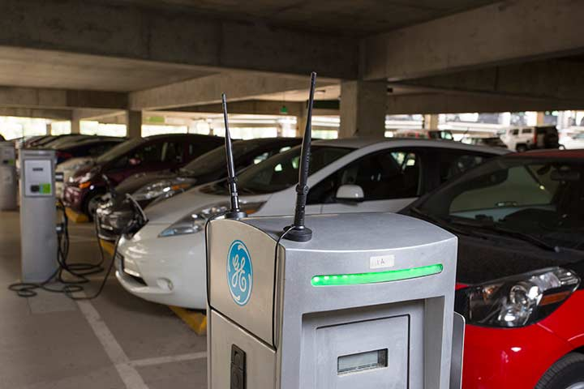
Mobile Charging
Electricity generation can be from energy storage (battery, supercapacitors, or hydrogen fuel cell), propane, natural gas, or diesel
Larger scale platforms can accommodate charging multiple vehicles
Deploy at any location
No need for permits, electrical upgrades, or construction
Source | NREL
NTX-REV Stakeholder Input Session
Notes:
Charging examples
No permanent charging infrastructure
Centralized fleet charging is inaccessible
Stranded EVs
Power outages
Inoperable chargers

Slide 23
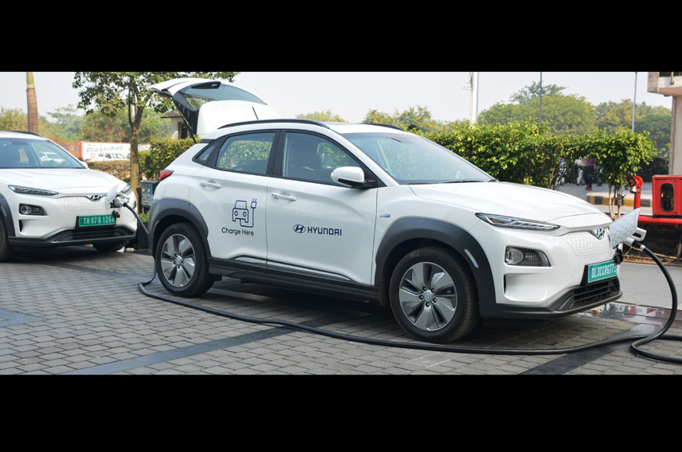
Bidirectional Charging
EVs able to discharge energy from the battery
A type of mobile energy storage
Provides alternating current to something else
Offer backup power in case of emergency
Focusing in on critical EV operations, the most relevant strategy would be:
Vehicle-to-Vehicle (V2V)
  Possible with proper plug adapter and charging connector
Source Autocar India
NTX-REV Stakeholder Input Session
Notes:
EVs able to discharge energy from the battery
A type of mobile energy storage
Provides alternating current to something else
Vehicle-to-Load (V2L)
i.e., appliances and electric tools
Vehicle-to-Vehicle (V2V)
Possible with proper plug adapter and charging connector
Vehicle to Grid (V2G)
An EV send power back to the electricity grid
Supply backup power
Vehicle to Home (V2H)
An EV is used to power your home

Slide 24
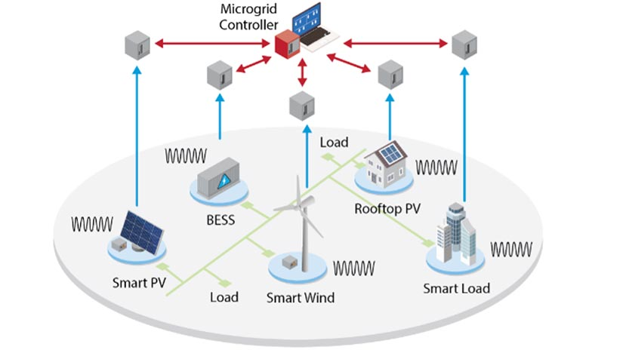
Microgrids
A combination of distributed energy resources (DERs) and electrical loads working as one unit
Can operate connected to the grid or off-grid (“island” mode)
Increased power transmission efficiency due to closer proximity to users
Reduces peak demand pressures enhancing overall energy security
Can include more renewable energy sources than the macro-grid; Scalable
Source: NREL
NTX-REV Stakeholder Input Session
Notes:
Tie back to smart charging management of the earlier slides

Slide 25
Discussion
What resilient technologies or strategies are you interested in? Do you have experience you would like to share?
Any you are not interested in or don't find suitable for the region or your organization?
NTX-REV Stakeholder Input Session

Slide 26
Gap Analysis and SWOT Analysis
Image Provided By Dallas Area Rapid Transit

Slide 27

GAP and SWOT Analyses
SWOT Analysis
Measure current ability of region to maintain critical operations during grid failure
  Strengths- What assets do we currently have to support our resiliency?
  Weaknesses- Where are current risks?
  Opportunities- What areas could we improve to better support resiliency?
  Threats- Obstacles that would preclude us from implementing the plan?
Gap Analysis
Identify difference between resilient charging infrastructure currently in the region vs what infrastructure and resiliency strategies are needed
NTX-REV Stakeholder Input Session
Source: Getty Images

Slide 28
SWOT Analysis
Strengths
Local Vehicle Electrification Plans and Goals
Local Emergency Preparedness and COOP Plans
Charging Infrastructure
Various Energy Sources
Regional Support and Mutal Aid Agreements
Weaknesses
ERCOT Grid Capacity and Constraints
Length of Outages and Frequency
Opportunities
Identify Critical Transportation Assets and Operations
Funding to Deploy Resiliency
Filling Gaps In Existing Local Vehicle and Infrastructure Electrification Plans
Peer Sharing
Threats
Rapid Population and Economic Growth
Frequency of Severe Weather
NTX-REV Stakeholder Input Session

Slide 29
Gap Analysis: Resilient Infrastructure Currently In Region
Resilient EV Infrastructure Inventory
Potential Critical Transportation Assets
Owner | Location | Strategy | Additional Resiliency Needed?
City of Irving | Library | Battery System | Potentially
Xcharge North America | City of Allen | Battery System with 3MWh | Potentially
City of Dallas | City of Dallas | Microgrid | Potentially
Owner | Vehicle Type | Vocation | Electric?
City of Plano | Electric sedan | Public Safety | Some
City of Plano | Refuse truck | Public Safety | Planned
Dallas Area Rapid Transit | Bus | Transit | Some
City of Denton | Fire Truck | Public Safety | Planned
City of Carrollton | Electric sedan | Public Safety | Some
Dallas County Sheriff's Office | Electric sedan | Public Safety | Some
What are the critical transportation assets in the region, or in your organization, that you want us to consider when planning?
NTX-REV Stakeholder Input Session

Slide 30
Questions?
Image Provided By Dallas Area Rapid Transit

Slide 31
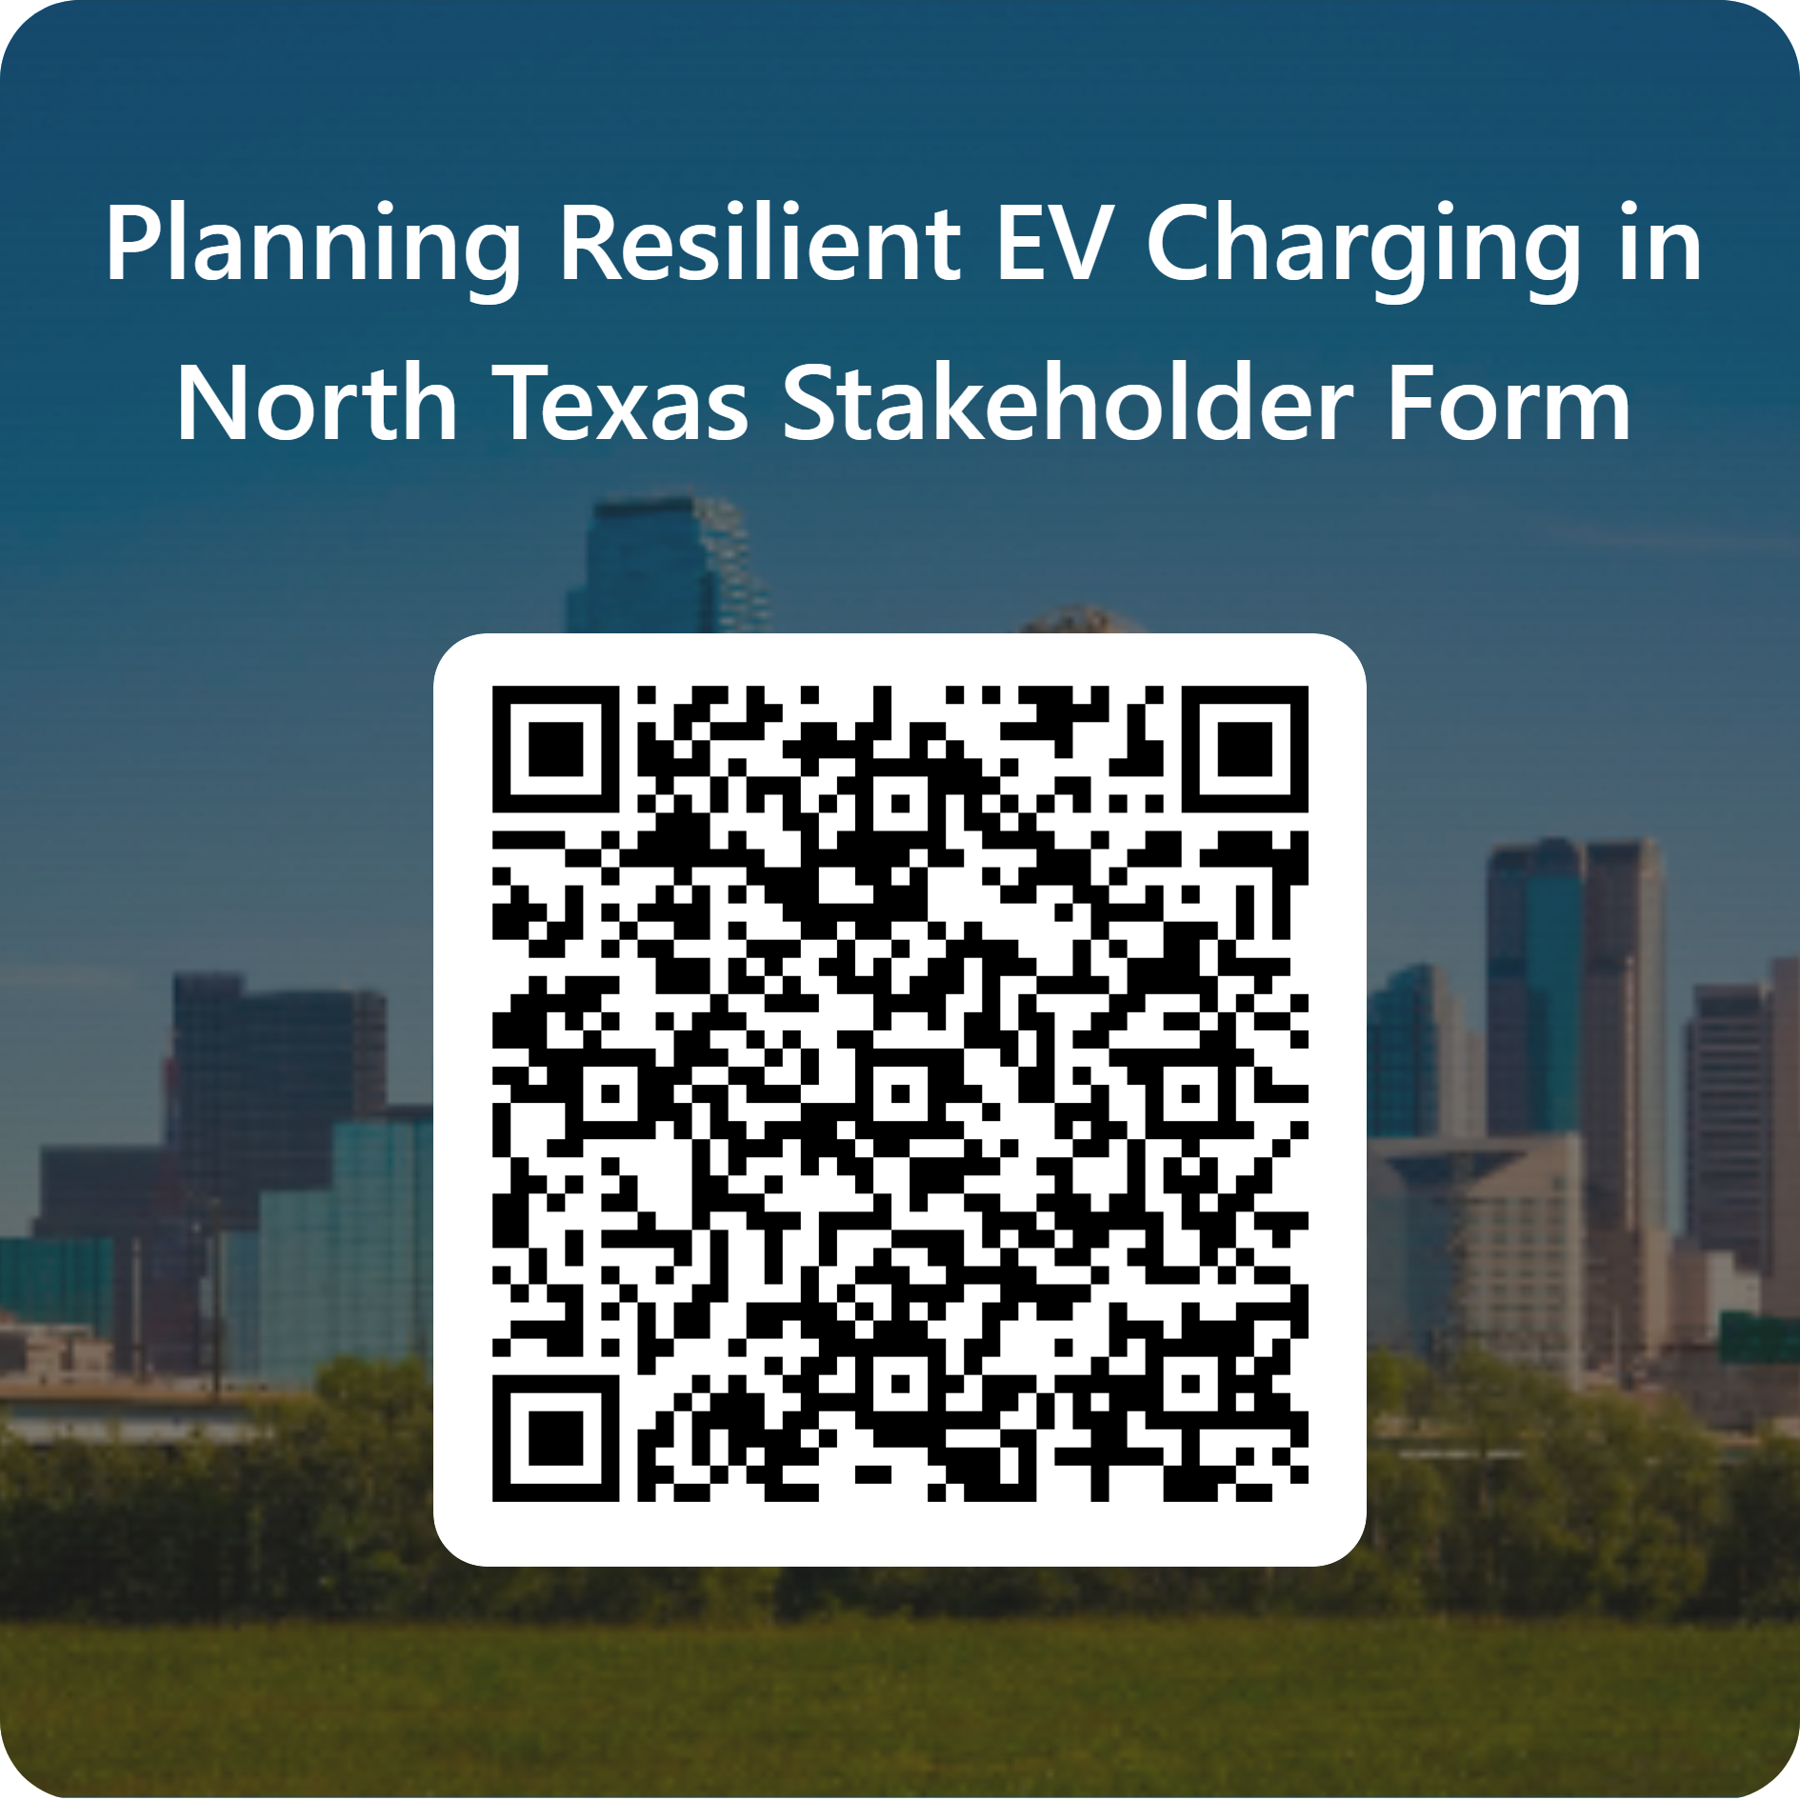
Next Steps
Complete Stakeholder Form
  Send form to any relevant potential stakeholders
  Check out the informational one-pager on this project
Stay tuned for our upcoming regional stakeholder engagement meetings
  May 28, 2025
  Potential tour May/June 2025
  July 30, 2025
  September 24, 2025
Contact us at cleancities@nctcog.org with any additional questions
NTX-REV Stakeholder Input Session
Notes:
Project Objectives:
Develop and distribute an EV charging resiliency plan for North Texas.
Implementation of the plan and adoption of resilient features into critical EV infrastructure throughout the region.
Identify resilient strategies, equipment, and technology to be tested through demonstration projects including:
Tabletop Planning Scenario
Technology and Equipment Demonstration
Project Impacts and Takeaways:
The plan is intended to provide guidance and actionable recommendations to regional stakeholders to ensure the continuity of operations of critical EV travel, such as:
Travel along evacuation routes.
Travel to and from critical facilities and by critical service providers (e.g., transit services).
Continuity of freight operations.

Slide 32





Contact Us
Lori Clark
Senior Program Manager
DFWCC Director
lclark@nctcog.org
Savana Nance
Principal Air Quality Planner
snance@nctcog.org
Justin Cox
Sr Emergency
Preparedness Specialist
jcox@nctcog.org
Hannah Thesing
Air Quality Planner II
hthesing@nctcog.org
dfwcleancities.org
Planning Resilient EV Charging in Texas | DFWCC
cleancities@nctcog.org
Dallas-Fort Worth Clean Cities: LinkedIn
Planning Resilient EV Charging

Slide 33
Case Studies and Whitepaper
City of Allen, Texas - A Superhub Project by XCharge North America
US Department of Agriculture Forest Service – Remote Charging Station
City of Phoenix, Arizona – Transportation Electrification Action Plan
Montgomery County, Maryland – Brookville Smart Bus Depot and Equipment Maintenance & Transit Operation Center (EMTOC)
NCTCOG-ResilientEVChargingInfrastructure-Whitepaper.pdf
Colorado DOT Resilience Improvement Plan

